Slide 1
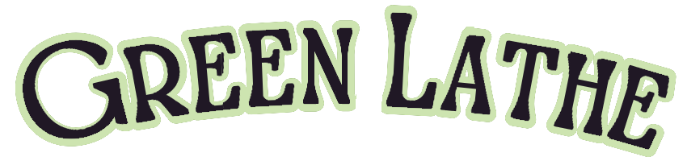
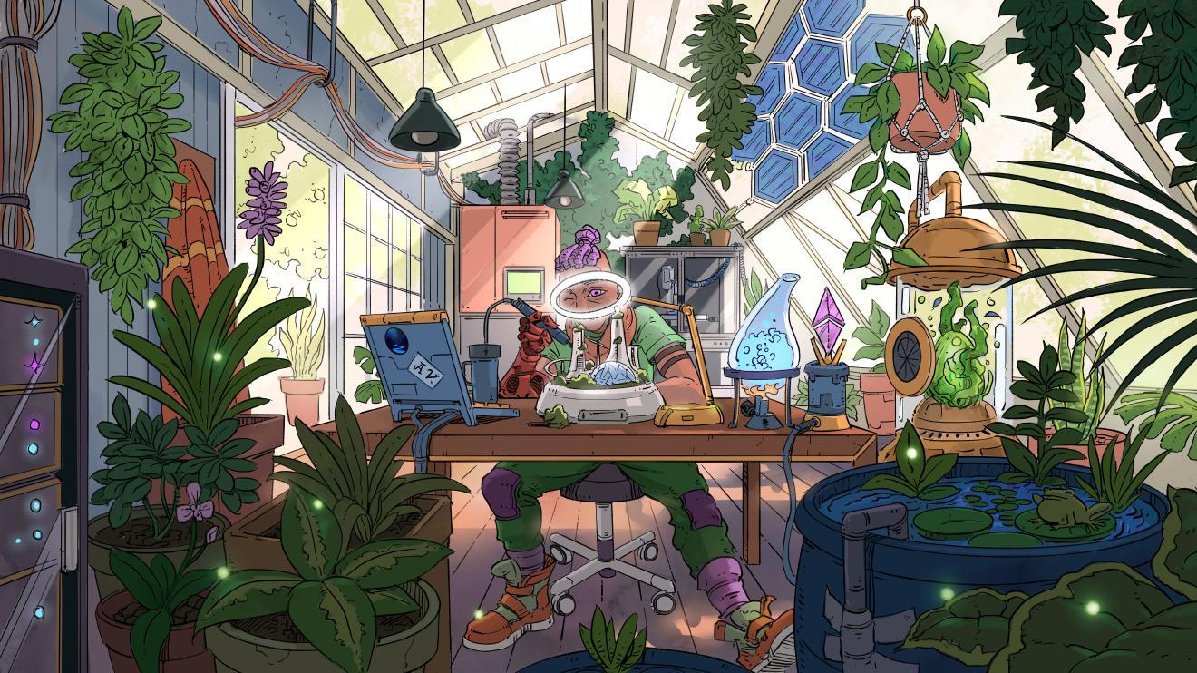
Welcome to
Intro and History
Who we are
Mission
Goals:
Open science
Legitimacy, rigor
Growing ethos
Radical community
Image: Solarpunk Lab by Karl Schulschenk
https://storyseedlibrary.org/art/karl-schulschenk-solarpunk-lab/
Notes:
Intro
Originally from West Virginia, and have lived in many states before coming to Virginia, where I am now.
Bachelors in Biology with a concentration in Ecology, Evolution, and Organismal Biology.
Master’s in agricultural science, project was in phytoremediation of salt pollution with hyperaccumulating halophytes.
I was lined up to join a PhD program in geospatial environmental analysis for spring of 2025 but funding fell through and the department is now being thoroughly shelled.
Worked in many science fields for 15 years, spanning between industry and academia, from lab management to ecological survey and reforestation to agricultural science to healthcare diagnostics.
Timeline of how GreenLathe came to be
Each year, I have a few months where I start to feel jaded about my scientific career. I became a scientist because I wanted to spend my career in a solutions-based community to make humanity’s existence on earth a more sustainable, harmonious experience and reduce the destruction that our species is so prone to causing.
I grew up in an area that was resource poor but rich in community and culture. While we couldn’t depend upon income, steady work, or the promise of a richer tomorrow, we could depend upon our friends, family, and neighbors for support when shit hit the fan - and it did, often. My town had annual floods, some of which were rather devastating. Housing insecurity and joblessness were major issues. The opiate epidemic hit Appalachia hard during my youth and still continues to this day. Growing up in this environment showed me the incredible power that a community has to be rich in resources beyond money and material assets. Because of my community, I was able to overcome considerable hardship to obtain an education, leave WV, and start a career.
What I’ve found after 15 years of a science career is…the world of science in the United States is very different from the world I grew up in. There is a lot of money tied up in places that don’t always makes sense. There’s a lack of community between institutions and across fields. Academia has publication-first culture instead of a solutions based culture, and so a lot of great ideas get buried in journals and are never used in a more meaningful capacity. Industry science is very capitalistic and often a shred of altruism will not be found there. The non-profit sector outside of academia is often resource-poor and full of highly spirited but exhausted workers and volunteers who don’t get enough materials or compensation to realize the resources they want to see.
And so, sometime last year I was feeling particularly jaded during my lunch break and started drafting a plan for what I wanted to see. What would science look like, in a future where humanity was living within the planet’s resources and trying to build something more bountiful than our current systems? What I came up with was imperfect, but it was something I saw promise in. It was GreenLathe!
GreenLathe is a collective and collaborative network driving scientific innovation rooted in solarpunk values which seeks to expower a sustainable and healthier future by connecting scientists, researchers, inventors, volunteers, activists, and need. Our mission is to empower solarpunk’s vision of the future through collaboration, open science, resource sharing, practical tools, and collective action to build a sustainable, equitable future. We believe that decentralized knowledge, equitable access, and working within our planet’s limitations is the only way to build a future sustainable future.
Our goals include expanding open knowledge and its accessibility, building legitimacy and scientific rigor into open source, growing the values of the solarpunk social movement in a crucial and impactful way to build a strong radical community among our global science kin.

Slide 2
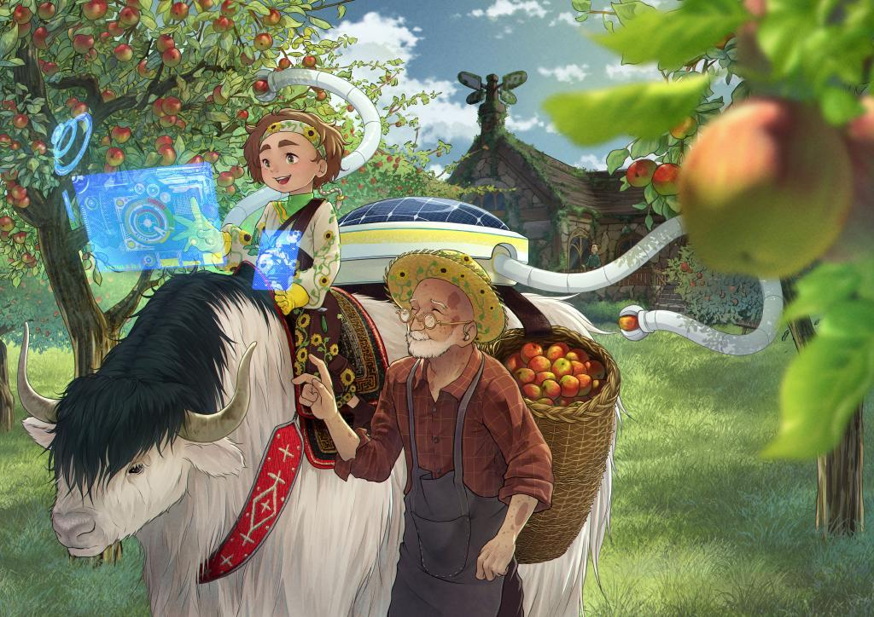
Solarpunk Science
Definition
Resource use crisis
Community, collaboration
Radically open science
Decentralized resources
Community resilience
Image: A Harvest of Knowledge by Yuuna Maiko
https://storyseedlibrary.org/art/yuuna-maiko-harvest-of-knowledge/
Notes:
I keep using the term “solarpunk” which some of you may not be familiar with. So what exactly is “solarpunk” and “solarpunk science?”
“Solar” comes from solar energy, the roughly 6 kilowatt hours that fall on any square meter on earth every day, captured by plants, solar panels, and indirectly via sea current, wind, and low impact hydro.
“Punk” refers to the DIY, grassroots, and decolonial counterculture aspects of the movement which empower community action, boost accessibility to knowledge, prioritize human wellbeing, a commitment to radical community and finding alternatives to capitalism.
So what is solarpunk science?
Solarpunk science is science conducted within the solarpunk ethos and vision of the future. This means actively aiming for a healthier future by working toward a harmonious and responsible relationship between humanity and the rest of life and resources on earth. Other aspects of the ethos includes fostering a robust interconnected network of global communities for support and resource sharing, encouraging radically open education, renewable energy, and replacing climate doomerism with active optimism.
This means using science as a tool to foster this brighter future. Regarding climate change, the general scientific consensus is crystal clear: the earth is experiencing rapidly accelerating global warming, caused primarily by human activity, and the current path we are on is a certain path to destruction of our biosphere to a scale that it will eventually no longer be conducive to supporting human life. The fight against anthropogenic global warming is primarily a fight of culture and class. We must push back against industrialism, corporatism, greed, inequitable power structures, and manufactured scarcity. As far as we know, Earth is the only planet in the observable universe which supports life - and that is worth protecting.
However, much of the current scientific industry is globally propped upon the shoulders of academia or private industry - and this comes with some issues. Many times scientific innovation comes from academia, which has been funded by public money for public good, and then is bought over or circulated through private corporatized systems. Sometimes private industry buys designs and protocols and buries them so they can keep their monopoly on the market. Some science never leaves the lab beyond a publication, and is ultimately forgotten. So much innovation is misappropriated or lost. Moreover, most of academic research is run through the nonprofit sector. Science which has been funded by the public should ultimately serve the public. And yet, much of the scientific industry does not become beneficial beyond the scope that capitalism allows. This is an example of systems exploiting the commons of the scientific community and privatizing work conducted within that commons in order to line their pockets at the expense of social good.
GreenLathe believes in rewriting the culture around the scientific industry and replacing it with a focus on a global scientific commons. By participating in radically open science, actively networking with resource-limited communities, and innovating by need, we can help build a better future.

Slide 3
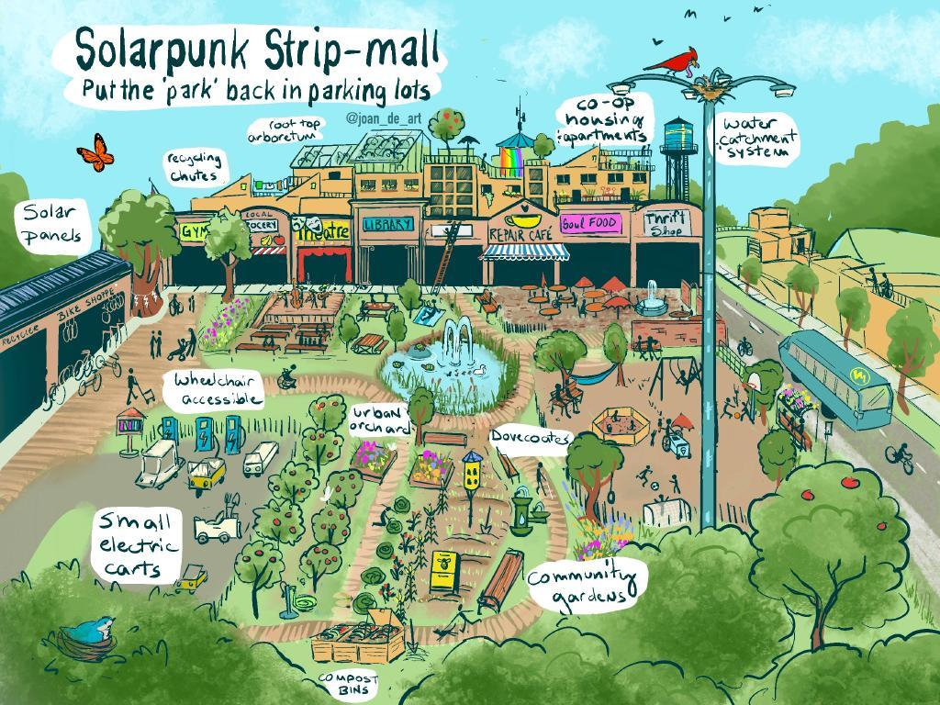
Science and the Future
Open science and innovation
Library culture/economy
Resources beyond money
Belongs in “The Commons”
Real world application
Image: Solarpunk Strip Mall by Joan de Art (Becca Bowlin)
https://storyseedlibrary.org/art/joan_de_art/solarpunk-strip-mall/
Notes:
How can science build the future we deserve?
By contributing to….
Open Science and Innovation - to share knowledge to maximum benefit, transparency, public access and input, and contribution
Library Culture and Economies - to share and decentralize resources as much as possible, to encourage global innovation and foster active equity beyond a scope that money alone will allow
The Commons - We regard knowledge and learning as a human right which means it belongs in “the commons”, or something which should be accessible to all humans in the same sense as air, water, and a habitable earth should be accessible to all humans.
Real world application- Finding optimal means to develop society’s future - balancing innovation with low-tech solutions, prioritizing design and function over needless iteration (like what’s happening during the current tech boom), factoring in needs and limitations of communities, ecologies, and resources.

Slide 4
So….what are we actually doing?

Slide 5
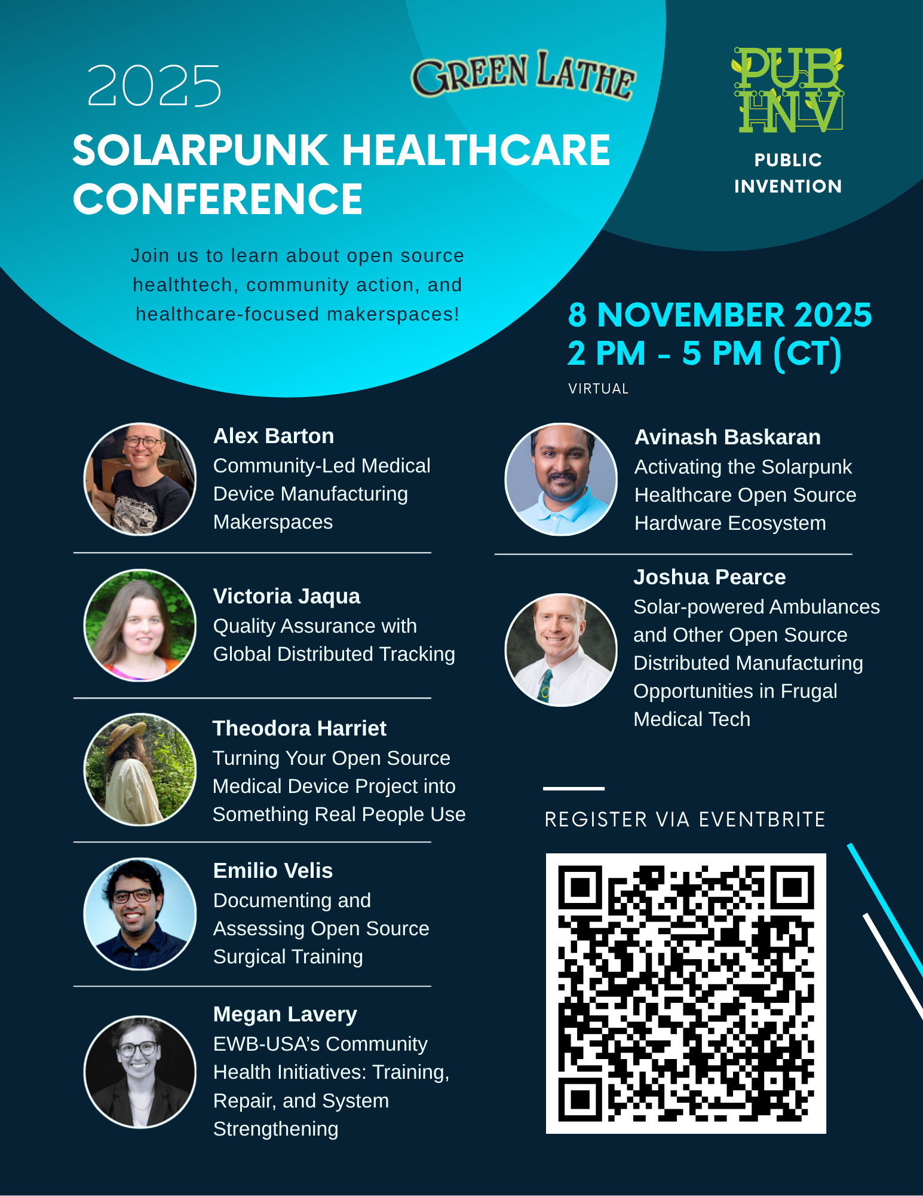
2025 Projects and Events
Workshop and Conference:
Science Writing Fundamentals: Reporting Your Research Findings at Any Stage of Your Project
Publishing in open science frameworks
Value beyond scholarly articles
Building a legacy outside of traditional pathways
Resource packet!!!
Pub Inv Science Writing Fellowship
Writing guides
Resources and platforms
Notes:
Science Writing Fundamentals: Reporting Your Research Findings at Any Stage of Your Project
Collaborative effort between Collaboratory Science, Public Invention, and GreenLathe, presented at the National Postdoc Association
This was our first ever workshop, but we hope it will be one of many! We plan to do a series of science writing workshops in the future, as well as other types of workshops
This workshop included examples of published work beyond the scope of traditional scholarly articles, incorporating value from open science frameworks, alternative publishing means such as raw data reporting, technical documentation, white papers, and more. This workshop served to show others how to claim their work outside of traditional publishing pathways, in order to build legacy as a researcher even when things are working against us.
We tried to use this workshop to set an important standard for future workshops, which will include a robust resource packet with the full presentation and transcript and all supplemental materials such as external resources, partnered programs, and other workshops.
This workshop includes information on Public Invention’s Science Writing Fellowship, which provides mentorship and a stipend to a select cohort of postdoctoral researchers in the applied sciences. Fellows will receive guidance, tools, and resources through program partners Collaboratory Science, GreenLathe, and the National Postdoc Association.
2025 Solarpunk Healthcare Conference was overall a success, showcasing many influential speakers in the realm of open healthcare, covering open source medical devices, quality assurance software and regulatory compliance within open healthcare, and community healthcare initiatives. On our website we have also included the resource packet for this conference which includes a copy of each presentation as well as relevant websites and external links which may be of interest to you, so please check those out.

Slide 6
The Future!
Planned Projects and Events
for
2026 and Beyond

Slide 7
Conferences and Workshops
Conferences: different interdisciplinary topics
Workshops:
Science Writing
Skills building
Expert discussion, guest speakers, project blocks
Community building exercises

Slide 8
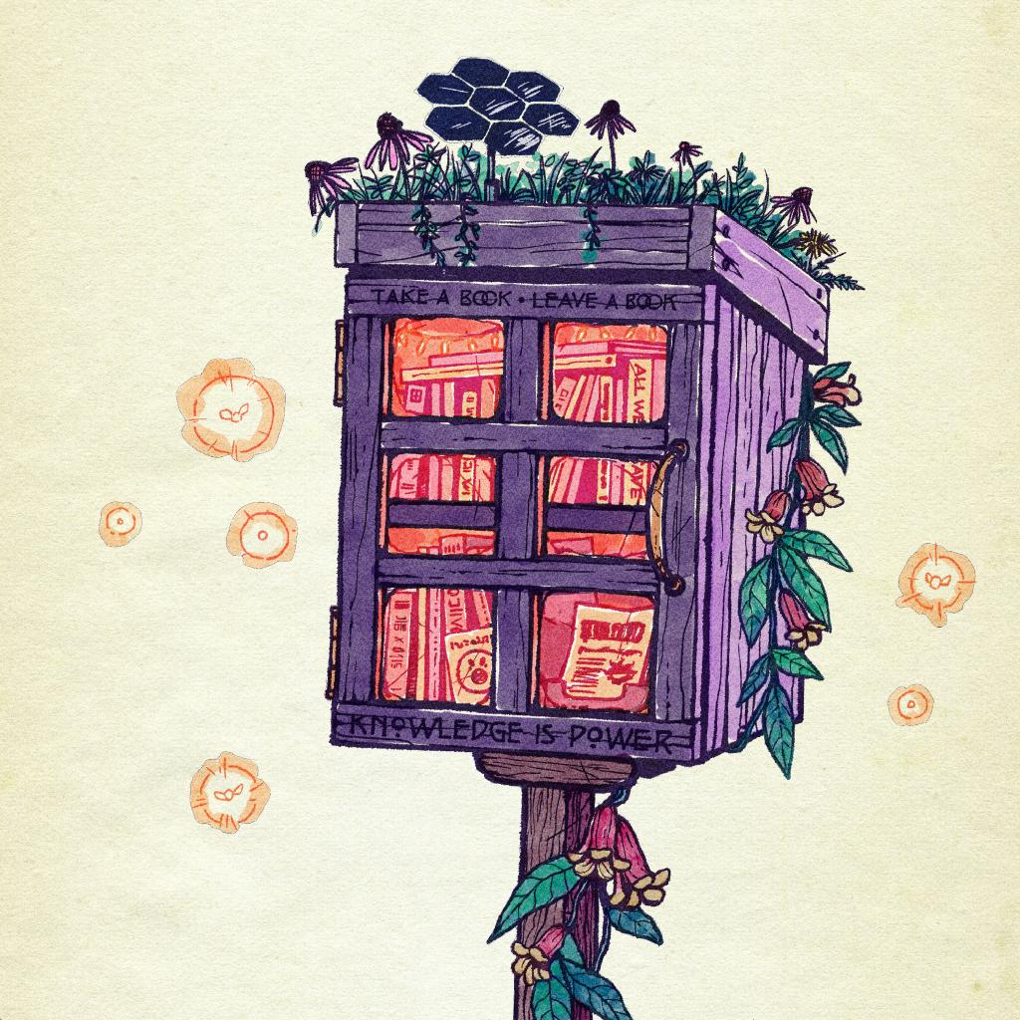
Digital Knowledge Commons
Open science data
Designs
Articles and technical guides
Image: “Knowledge is Power” by SolHaelan
https://storyseedlibrary.org/art/solhaelan-knowledge-is-power/
Notes:
We are currently planning to create a digital library to provide open science data, scientific articles, compilations, and designs for GreenLathe projects. Our aim for the Digital Knowledge Commons is to encourage transparent reporting, promote science communication, and to provide useful information which support solarpunk science endeavors.

Slide 9
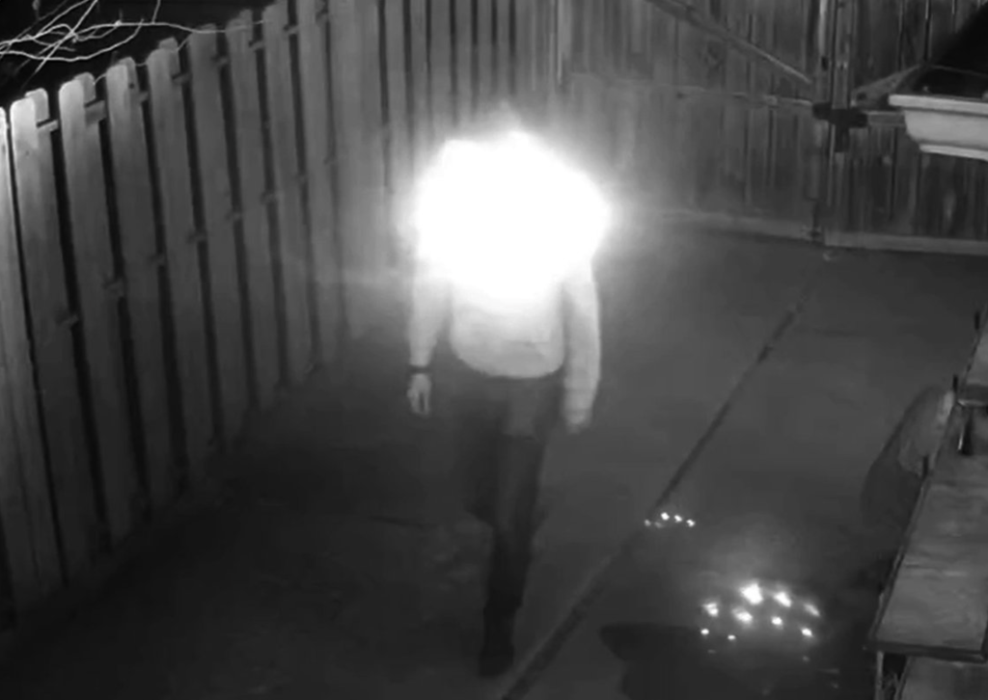
Hide in Plain Sight - Exploratory Study
Exploratory study of fashion products aimed at protecting identity
What works? What doesn’t?
Differences between surveillance tools and their usage
Images: https://www.vice.com/en/article/this-hacker-hoodie-uses-surveillance-camera-parts-to-blind-surveillance-cameras/
Notes:
Data privacy is an important aspect of equity, especially in a world where data privacy infringement is as common as the air we breathe.
The HIPS study aims to be an exploratory study of the efficacy of fashion products aimed at protecting the wearer’s identity. This study will be a collaborative project between GreenLathe and Collaboratory Science.

Slide 10
Open Source Technical Guides
Accessible technical guides for openly published tech
Zine style prints or other space-saving print styles
Multiple languages
Supplemental materials: data, hazards, considerations
Redundant publication, freely circulated
Notes:
We are currently planning to create technical guides for open source designs. The purpose of these guides is to address gaps in open design knowledge. There are many designs of appropriate technologies currently posted on the internet which contain useful material, but no comprehensive instruction manual or supplemental information, such as testing data, to accompany it. These guides will be written with extremely accessible language and hopefully translated into other languages eventually.
This project will be at least partially partnered by Appropedia, as they are the largest housing of information on appropriate technologies and open tech designs aligned with our scope.

Slide 11
STEM for Community Resilience
Technical guides and trainings for post-disaster immediate needs:
Clean water (modular, reliable, supportive size)
Energy (modular, renewable, frugal)
Communication (meshnet, LoRa, etc)
Competitions for frugal post-disaster innovation (i.e. emergency batteries)
Building exchange networks, makerspaces, storage for equipment, mapping for community
Notes:
Tentative partners may include Collaboratory Science and the Precision Agronomy Research Center, as part of a larger project hopefully!

Slide 12
Certifications
Science writing
Technical documentation
Skills building workshops
STEM for community resilience
Quality and compliance in open science

Slide 13
Technology for A Better Tomorrow - Mapping and Simulation
Makerspace mapping - network building
Optimized Urban Green Spaces - Geospatial mapping project (Drea Renshaw, GreenLathe)
Solarpunk Worldbuilding Software (Elijah Claude, GreenLathe)
Notes:
Long time down the road, but the blue prints have already begun
Solarpunk worldbuilding software - software for non-technical people to build virtual worlds, based off of the current world. Simulating solarpunk solutions and systems in a way which illustrates impact on a localized area
The solarpunk movement is generally highly in favor of portraying things through story and illustration methods. Telling the story of the future we want is infinitely more effective than raw data.

Slide 14
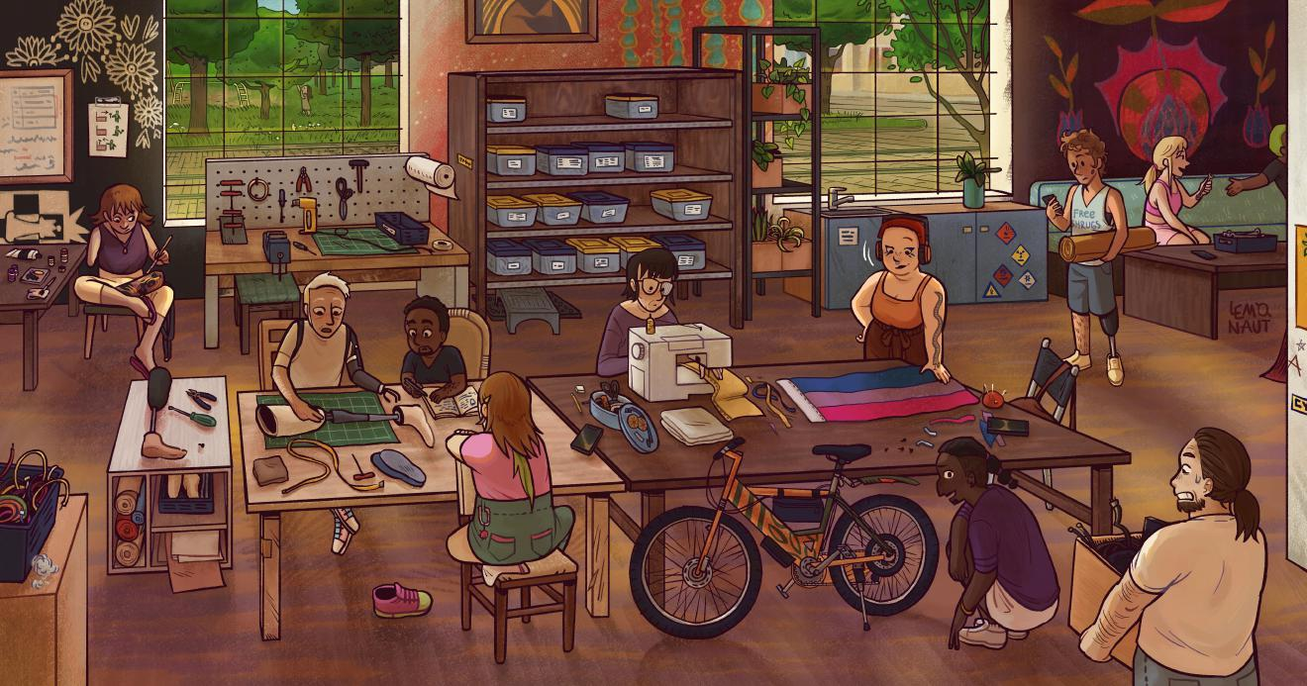
Join us! What to expect in 2026
Discord - come chat!
Small meetings - 1st SUNDAY
Big meetings - 3rd SUNDAY
Official incorporation!
Getting grants, starting projects
Conferences and workshops
Image: A prosthesis maintenance day at the hackerspace by The Lemonaut
https://storyseedlibrary.org/art/the-lemonaut-hackerspace/

Slide 15
What we need for 2026
DONATIONS!!!!
Volunteer and board insurance
Supplies for prototypes and testing
Operational costs - website, software licenses, etc
Volunteers for projects
Community members - come talk to us on Discord!
Notes:
We are a new organization, only launching officially about 4 months ago. The support we have received in that short time has been incredible and very inspiring. With a growing community, a little elbow grease, and financial support, we will get to tackle our goals for 2026.

Slide 16
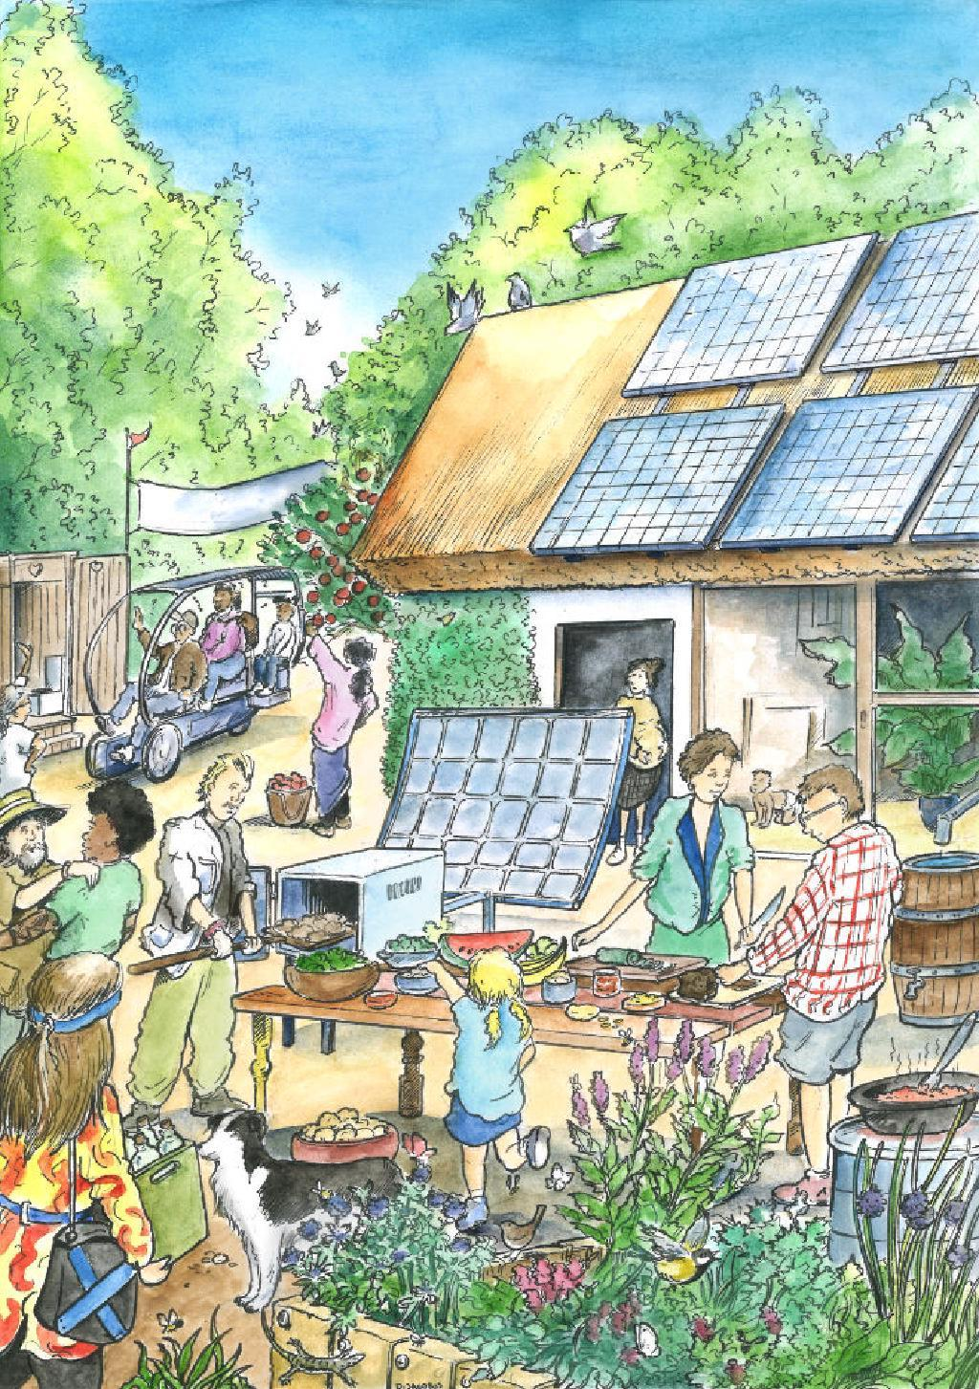
Discussion time!
Contact me at collaborate@greenlathe.org
Website: https://www.greenlathe.org/
BIG THANKS to:
Public Invention and our network of spirited nonprofit friends
GreenLathe members - you’re amazing!
Pawel Ngei and the Story Seed Library’s incredible collection of art
Image: Low tech Journal: Potlatch by Dustin Jacobus
https://storyseedlibrary.org/art/dustin-jacobus-low-tech-journal-potlach/

