Slide 1

Quality Assurance in the Food Industry
Ensuring Safety, Consistency, and Reliability
Rosie Yagmur Yegin, PhD

Slide 2
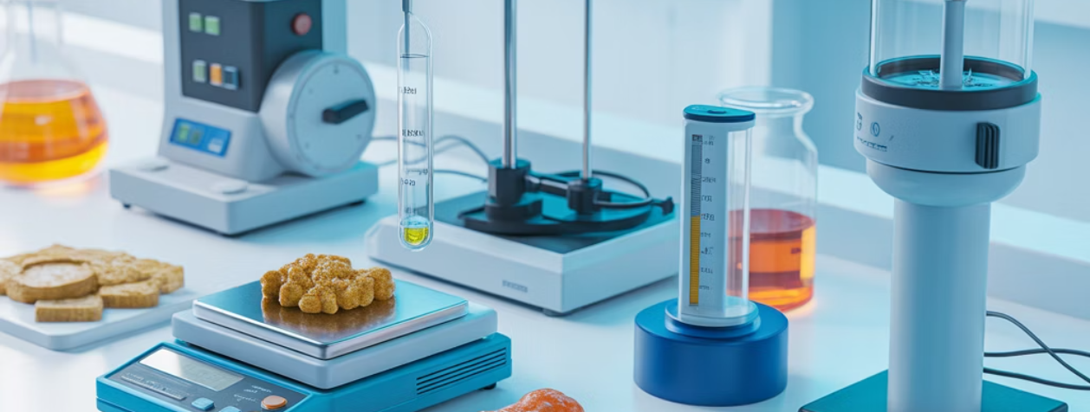
What is Quality Assurance?
Quality Assurance (QA) is a proactive, prevention-focused system integrated into every stage of food production. It anticipates and prevents potential issues, building food safety and quality directly into the process from the start, fostering a culture of excellence.
Key Aspects of QA
QA vs QC: Understanding the Difference
Prevention-focused: Establishes robust protocols to avoid defects.
Process-oriented: Systematically integrated throughout food production.
Quality Assurance (QA)
Proactive approach: Addresses potential issues before they occur.
Prevention-focused
Entire production system: Ensures quality from raw materials to finished goods.
Process-oriented
Proactive approach
Builds quality in: Ensures food safety and quality are inherent to the process.
Entire production system
Prevents defects
Quality Control (QC)
Detection-focused
Product-oriented
Reactive approach
Final product testing
Identifies defects

Slide 3
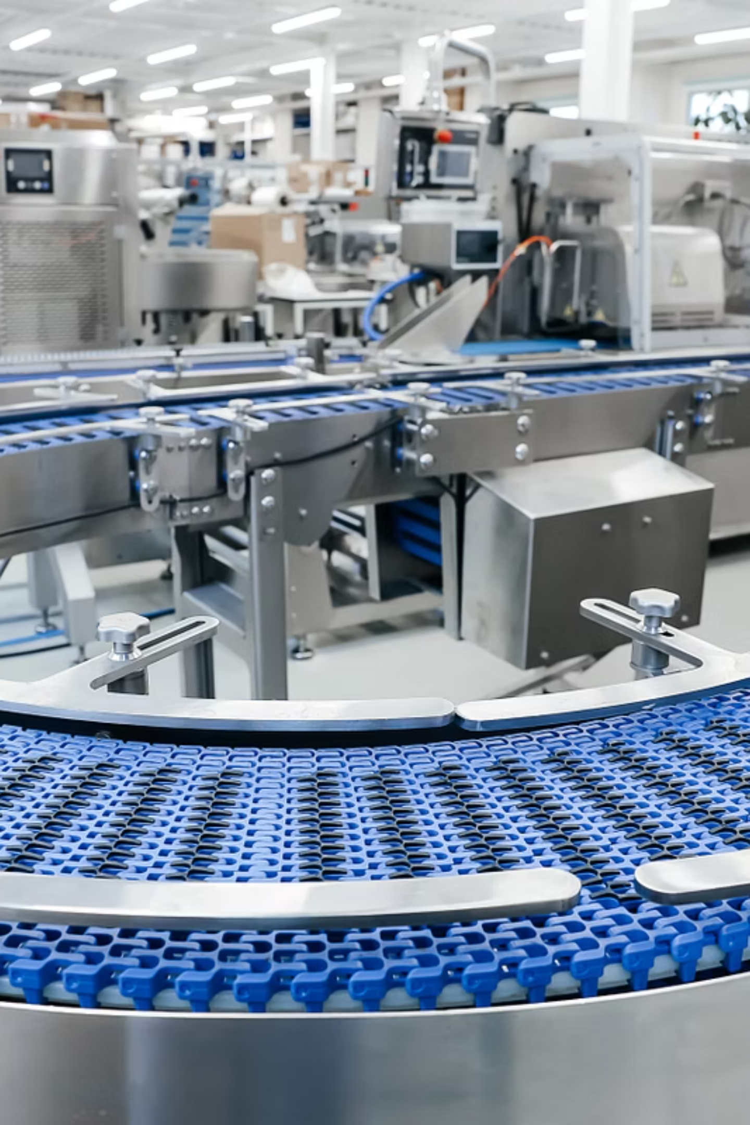





The Five Stages of QA Implementation
Our robust Quality Assurance (QA) system follows five systematic stages to ensure product safety and consistency from beginning to end.
Source Quality
Audits and testing verify incoming materials, ensuring only approved ingredients enter production.
Process Control
Adherence to SOPs and validated parameters (temp, time, pH) throughout production.
Real-time Checks
Continuous monitoring and sample analysis at Critical Control Points to identify and correct deviations.
Product Release
Final testing (microbiological, sensory, shelf-life) ensures products meet all standards before distribution.
Improve & Adapt
Documentation supports traceability, trend analysis, and data-driven optimization for ongoing enhancement.

Slide 4






Core Principles Driving Quality Assurance
Our core Quality Assurance principles are essential for achieving operational excellence, building trust, and delivering consistent value.
Standardization
Consistent procedures eliminate errors and ensure reliability, potentially saving up to 15% in rework expenses.
Traceability
Full transparency allows quick issue resolution and builds consumer trust, potentially reducing recall impact by 80%.
Distributed Application
QA principles ensure consistency across multiple sites, suppliers, and shift-based teams, maintaining safety and quality even when operations are decentralized.
Real-time Monitoring
Proactive monitoring detects and prevents problems before they grow, effectively cutting material waste by 10-20%.
Continuous Improvement
We constantly refine processes to enhance quality and drive market leadership, boosting customer satisfaction by up to 25% annually.

Slide 5
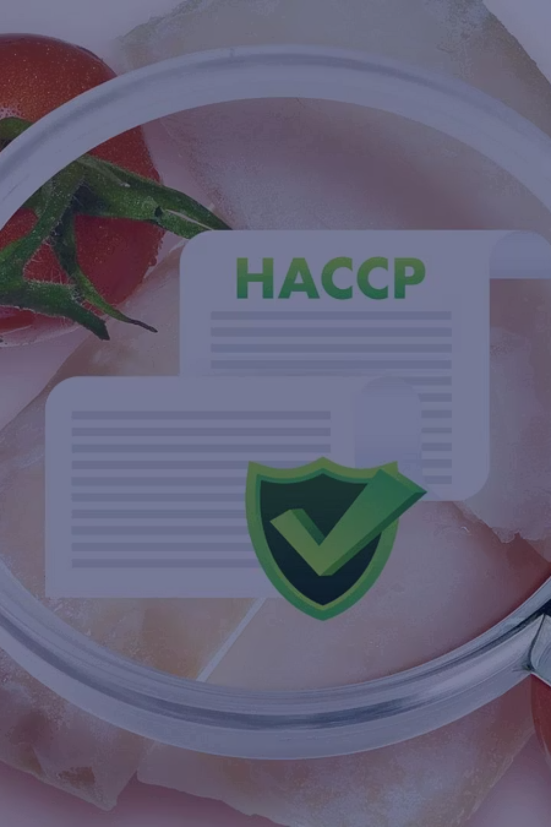
Regulatory Compliance: Building Trust Through Standards
Aligning with food safety regulations is a strategic pathway to success. It builds consumer trust, enhances brand reputation, and unlocks new market opportunities.
HACCP
GMP
Identifies and controls food safety risks, ensuring safer products and brand integrity.
Ensures consistent product quality through fundamental hygiene and process practices.
ISO 22000
FDA
Global food safety framework, demonstrating commitment to international standards and market access.
Enforces critical U.S. food safety laws, preventing recalls and ensuring national benchmarks.
USDA
Ensures safety of specific food products, guaranteeing market viability and consumer confidence.

Slide 6
The Multifaceted Benefits of Quality Assurance
A strong Quality Assurance (QA) program goes beyond mere compliance, offering significant advantages that drive success across all aspects of food manufacturing.
🛡️ Protects Public Health
💰 Reduces Recall Costs
QA's core mission is to protect consumers from unsafe products and foodborne illnesses. Robust QA systems prevent contamination, ensuring safe food reaches millions daily.
Recalls are financially devastating, causing significant brand damage and costing millions. QA proactively prevents these costly incidents, making it a high-ROI investment.
🤝 Builds Brand Trust
⚡ Improves Operational Efficiency
Delivering safe, high-quality products consistently builds strong customer loyalty and trust. A solid QA reputation enhances transparency and provides a powerful market advantage.
QA streamlines operations by reducing waste and optimizing processes. This leads to higher throughput, lower costs, and improved resource use, boosting overall efficiency.

Slide 7

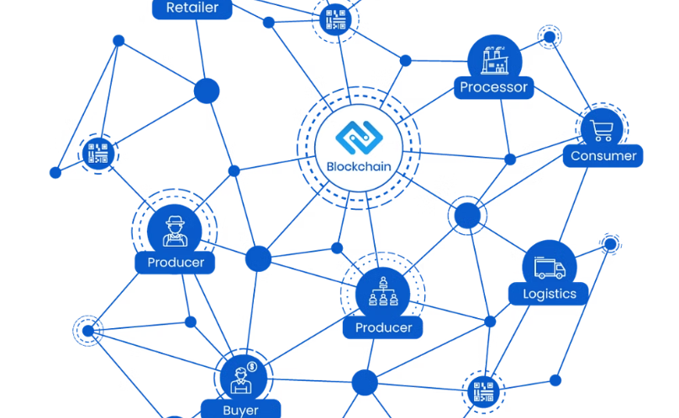
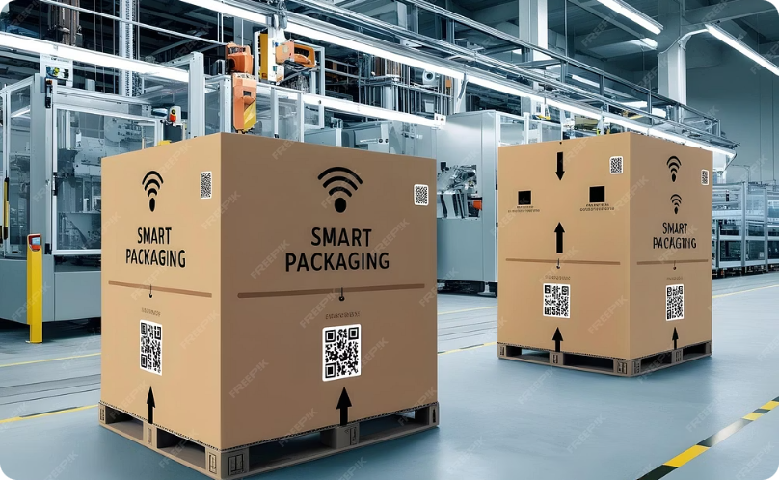

Future Innovations Transforming Quality Assurance
AI & Sensor Monitoring
Blockchain Traceability
Smart Packaging QA
Automated Digital Audits
AI and sensors detect issues in real-time, predict failures, and ensure consistent product quality proactively.
Blockchain creates immutable records for instant traceability, ensuring transparency from farm to consumer.
Smart packaging monitors freshness, temperature, and tampering, providing product history and authentication.
Automated digital audits replace paper, track compliance, and drive enterprise-wide improvements efficiently.

Slide 8

Key Takeaways
Quality assurance protects consumers, strengthens brands, and drives operational excellence.
QA is Prevention
QA Ensures Compliance
Proactive QA builds safety and quality, preventing issues, saving time and money.
Meets regulatory requirements and standards, strengthening operations, opening new markets.
QA Protects Reputation
QA Drives Improvement
Ensures safe products; builds consumer trust and strengthens brand reputation.
Continuously optimizes processes, fostering competitiveness and resilience through data and action.

